Slide 1
Graph Attention Network
Paper Summary

Slide 2
Contents
Abstract
Introduction
GAT Architecture
Graph Attention Layer
Comparisons to related work
Evaluation
Datasets, State-of-the-art methods and Experimental Setup on
Transductive Learning
Inductive Learning
Result
Conclusions

Slide 3
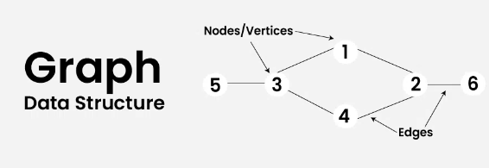
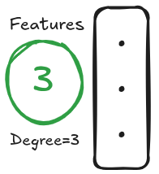
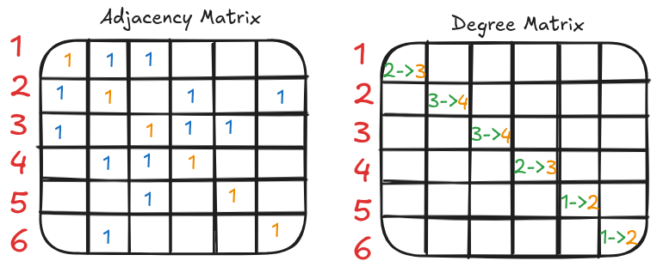
Overview
Link: Graph DSA

Slide 4
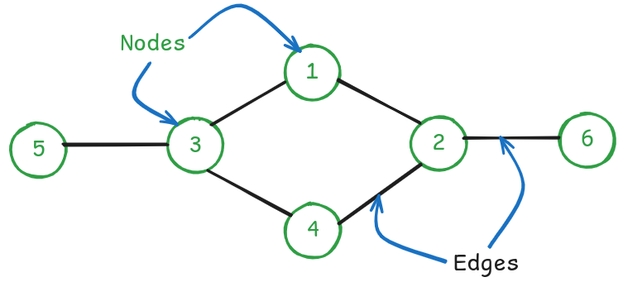
Graph Data
Structure:

Slide 5
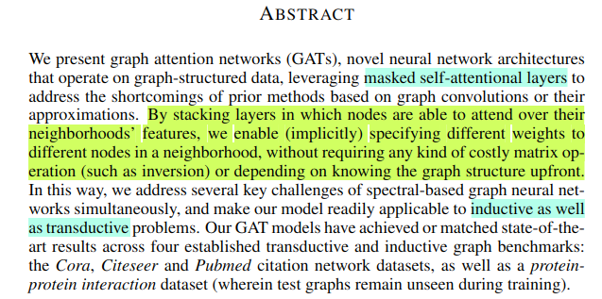
Abstract
Specifying different weights to different nodes in a neighborhood
⇒ attention

Slide 6
Theory:
Transductive Learning:
Transductive learning is designed to make predictions specifically on a fixed set of test examples, which are known during training but without labels. In essence, transductive learning uses information from the test set structure (like graph connections) to improve prediction accuracy on this specific test set.
Limited to static graphs or fixed datasets
Test data structure is known during training
Predicts for a fixed set of test points

Slide 7
Theory:
Inductive Learning:
In inductive learning, the model is trained to generalize from the training data to unseen data. This is the typical approach in supervised learning where, after training, the model can make predictions on any data that fits the learned patterns. Inductive GNNs are designed to generalize to new nodes or even entirely new graphs that were not part of the training set.
Flexible, supports dynamic data
Test data is unseen during training
Generalizes to unseen data

Slide 8
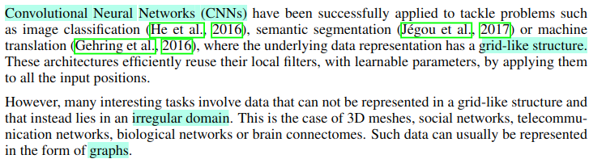
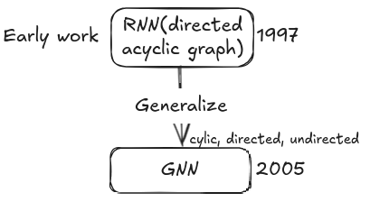
Introduction

Slide 9
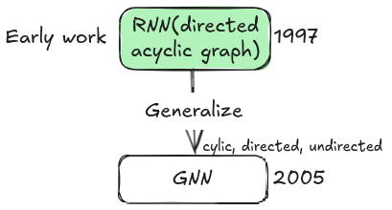
Introduction
I → am → learning → graph

Slide 10
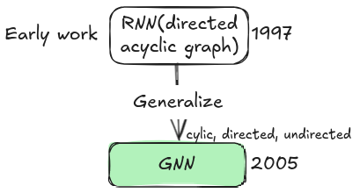
Introduction
GNNs consist of an iterative process, which propagates the node states until equilibrium; followed by a neural network, which produces an output for each node based on its state.
Iterative process: Iterative message passing (aggregate info from its neighbors in each node)
Equilibrium: Stabilize capturing the graph structure and feature dependencies.

Slide 11
Introduction
GNNs consist of an iterative process, which propagates the node states until equilibrium; followed by a neural network, which produces an output for each node based on its state.
Iterative process: Iterative message passing (aggregate info from its neighbors in each node)
Equilibrium: Stabilize capturing the graph structure and feature dependencies.

Slide 12
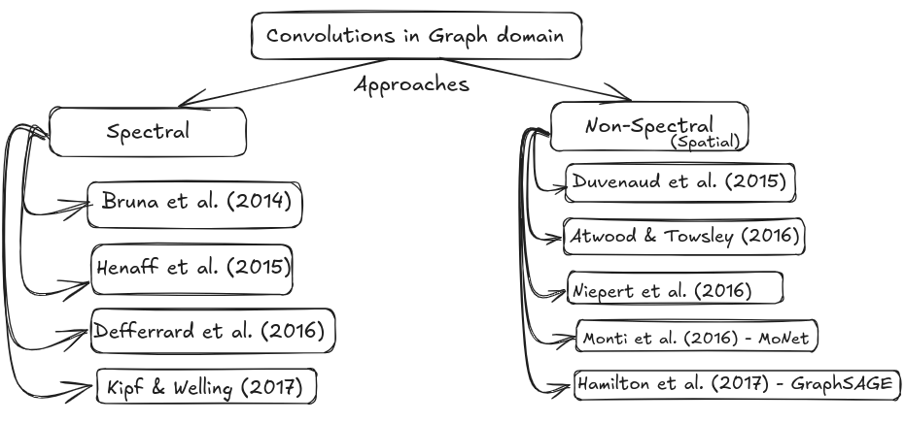
Introduction

Slide 13
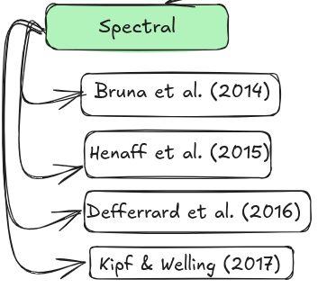
Introduction
Spectral methods define convolution using the frequency (spectral) properties of the graph and rely on graph Laplacian by computing (decomposition) eigenvalues and eigenvectors.
Computationally expensive
Limited to specific graph structure

Slide 14
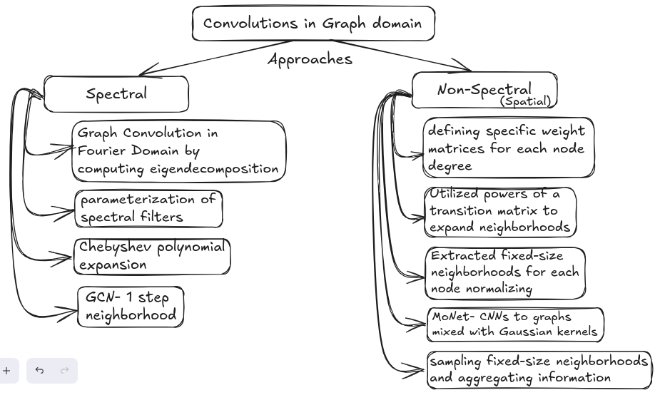
Introduction

Slide 15
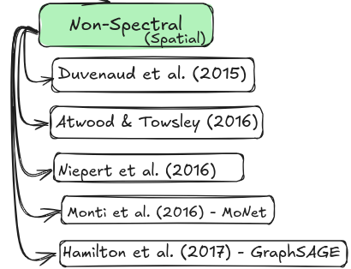
Introduction
These methods define the convolution operation based on local node neighborhoods without transforming into the frequency domain (i.e directly in the spatial domain). Spatial methods operate locally on each node and its neighbors, avoiding the costly eigenvalue computations.
Computationally efficient, flexible
Generalizes well to new graphs
Inherently localized (focused on neighbors)

Slide 16
Introduction

Slide 17
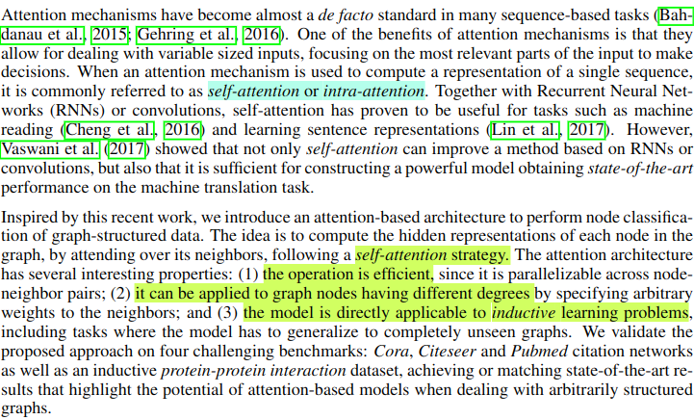
Introduction
Next paragraph includes the connected works (for details find the paper)

Slide 18
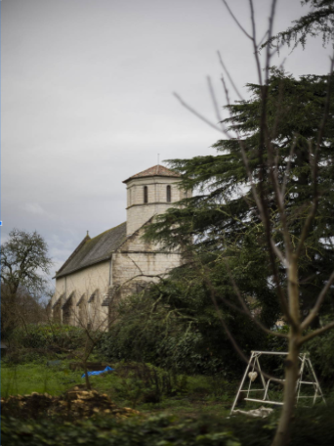
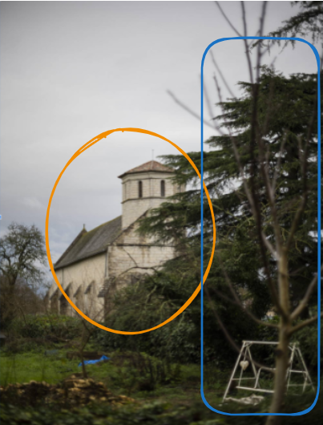
Attention
Let’s see the image:

Slide 19
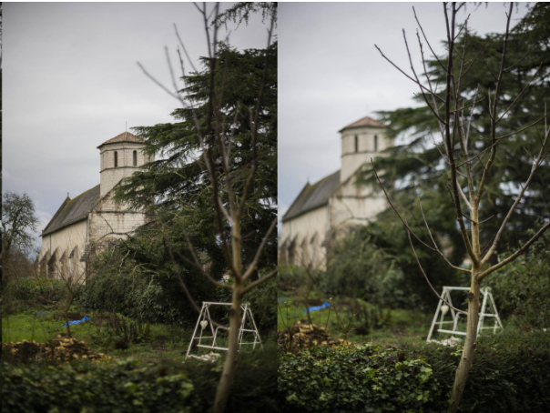
Attention

Slide 20
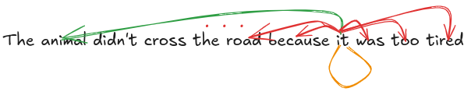
Attention
Self-Attention
Don't forget to consider every detail carefully when making decisions that could impact your project’s success.
If model forgets the word ‘Don’t’, this gets completely opposite meaning. So, main idea is to have the direct access to the inputs.

Slide 21
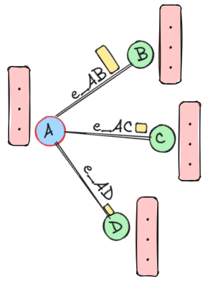
Attention in Graphs
Let this is the social network, Node represents people and edges represent connection or friendship among them. Each node (person) has its own features or traits.
We want to predict a person’s interests based on friend’s interest on person A.
We apply attention mechanism to find score on how similar the features of 2 connected nodes are.
On result, from our side social network graph, person B will have more influence on person A’s updated feature.

Slide 22
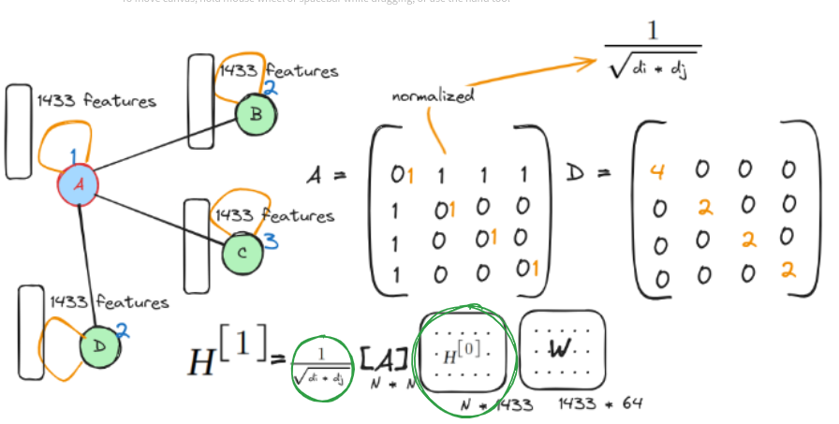
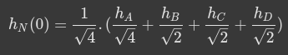

Slide 23
GCN paper explained slide
No of Connections

Slide 24
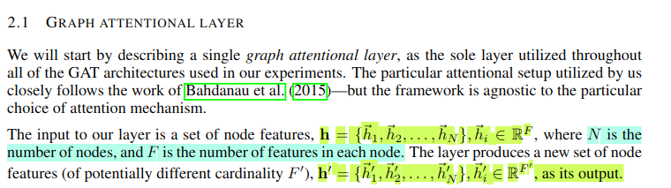
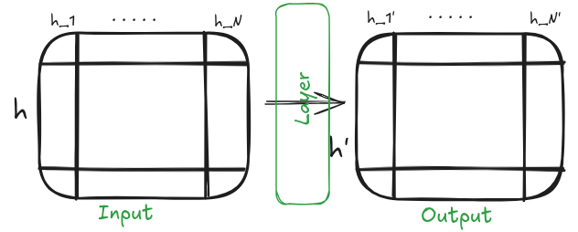
GAT Architecture: Graph Attention Layer

Slide 25
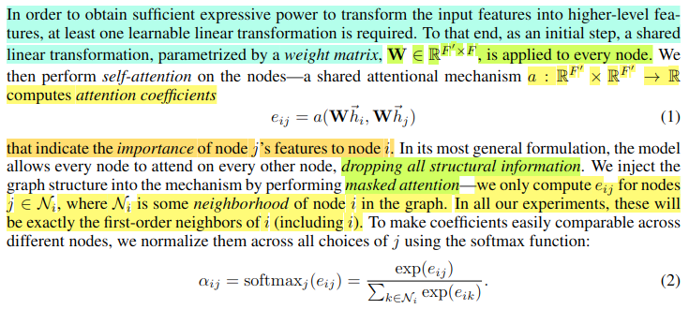
GAT Architecture: Graph Attention Layer

Slide 26
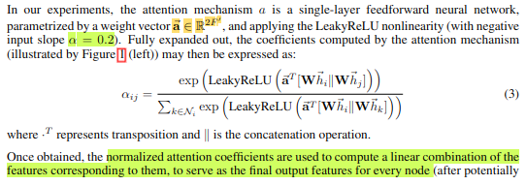
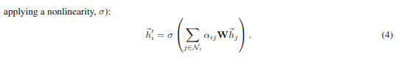
GAT Architecture: Graph Attention Layer

Slide 27
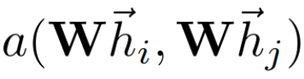
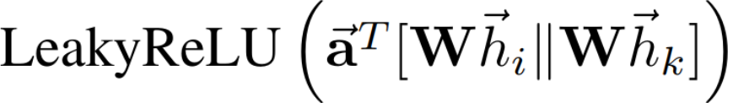
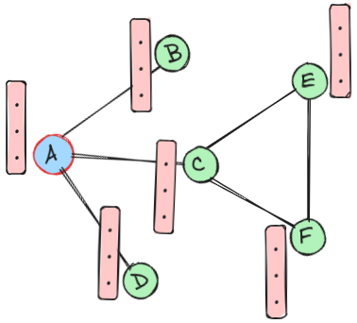
GAT Architecture: Graph Attention Layer
=

Slide 28
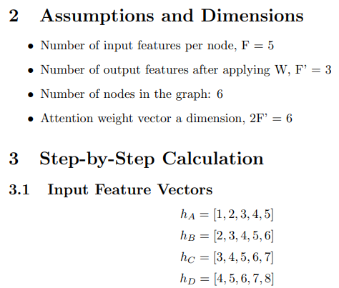
GAT Architecture: Graph Attention Layer

Slide 29
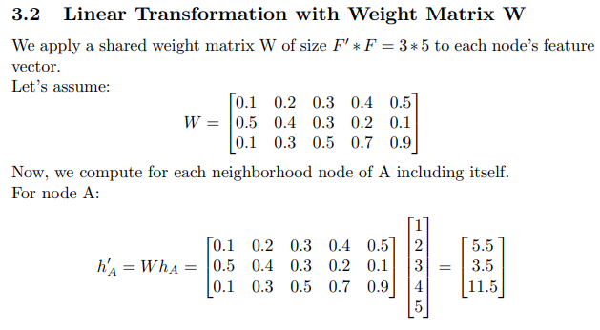
GAT Architecture: Graph Attention Layer
Similarly compute for node B, C, D.

Slide 30
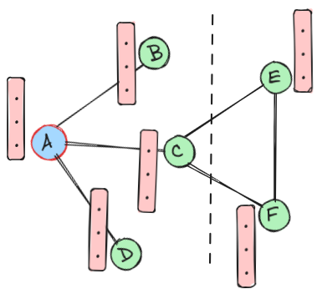
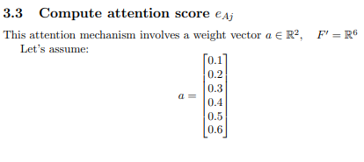
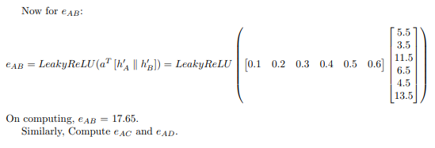
GAT Architecture: Graph Attention Layer
Masked attention ensures that attention coefficient will be computed from its immediate neighbors in the graph.

Slide 31
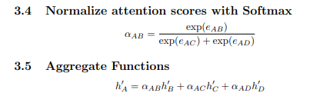
GAT Architecture: Graph Attention Layer
+ exp(e_AB)
‘

Slide 32
GAT Architecture: Graph Attention Layer

Slide 33
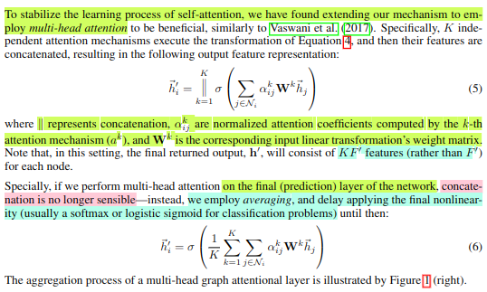
GAT Architecture: Graph Attention Layer

Slide 34
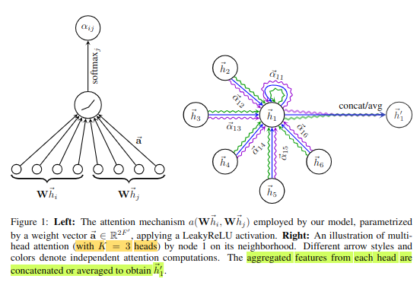
GAT Architecture: Graph Attention Layer

Slide 35
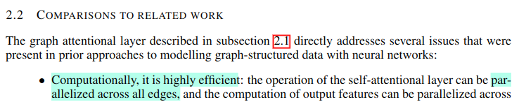
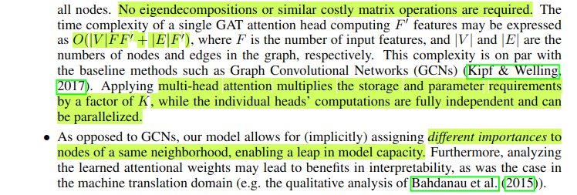
GAT Architecture: Comparisons to related work

Slide 36
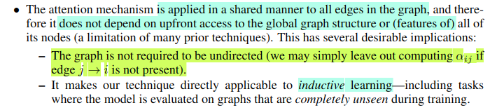
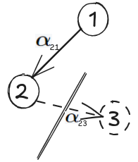
GAT Architecture: Comparisons to related work
Example: if we consider for node 2, we don’t need to calculate \alpha_23 since the edge from 3 to 2 is not directed. Node 3 doesn’t directly influence node 2.

Slide 37
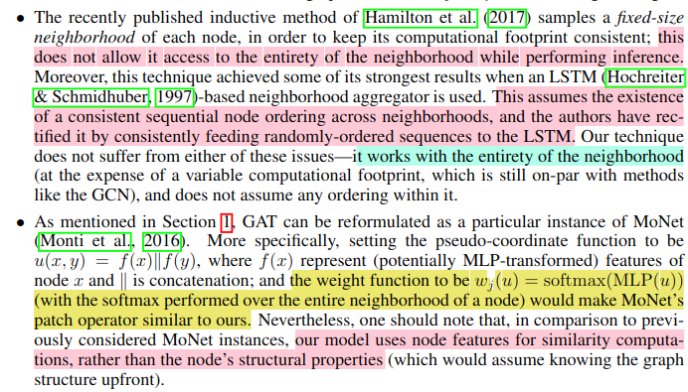
GAT Architecture: Comparisons to GraphSAGE and MoNet

Slide 38
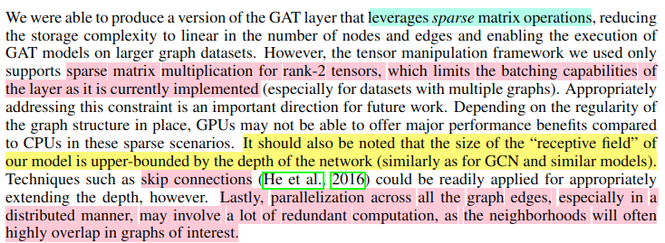
GAT Architecture: Comparisons to related work

Slide 39
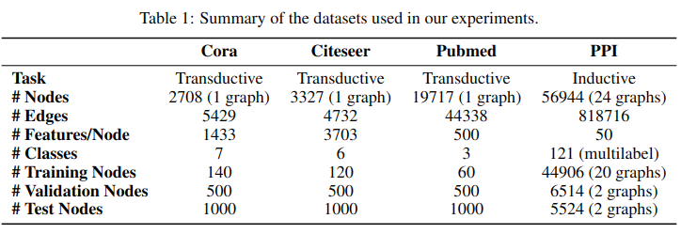
Evaluation:
Dataset:
Transductive learning: 20 nodes per class to be used for training—however, honoring the transductive setup, the training algorithm has access to all of the nodes’ feature vectors.

Slide 40
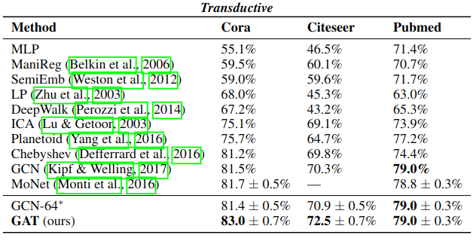
Evaluation:
State-of-the-art Methods: Transductive and Inductive Learning (Results)

Slide 41
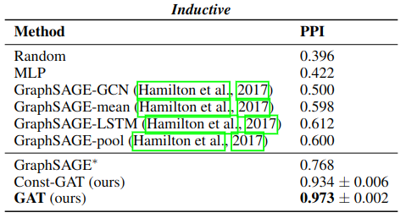
Evaluation:
State-of-the-art Methods: Transductive and Inductive Learning (Results)
Note: Experimental Setup is not included in this presentation which will be checked during implementation

Slide 42
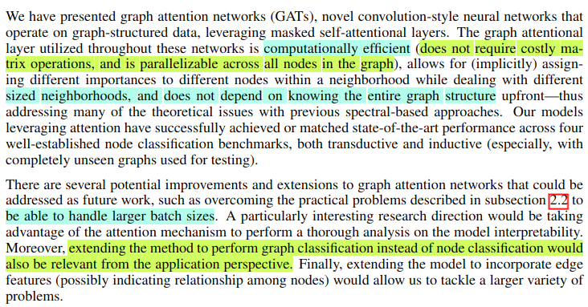
Conclusion

Slide 43
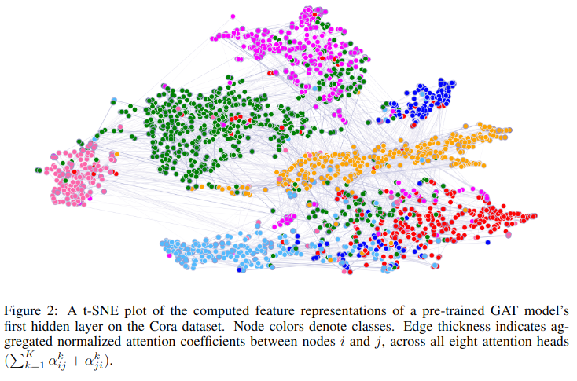
Conclusion

